Slide 1
Faculty Recruitment An Unbiased Approach
Presented by WISE@OU (Women in Science and Engineering at Oakland University)
The WISE@OU project is supported by a National Science Foundation ADVANCE Partnerships for Adaptation, Implementation, and Dissemination (PAID) grant (Award Number 1107072).
WISE@OU Leadership Team and Staff: Kathleen Moore, Brad Roth, Laila Guessous, Julie Walters, Joi Cunningham, Jo Reger, and Leanne DeVreugd.

Slide 2
Hiring a Diverse Faculty
What is a “diverse” faculty?
Diversity is more than just visual differences.
It includes race, ethnicity, age, sexual orientation, place of origin and/or residence, but also variations in ideas, methods, and opinions.
Notes:
“Diversity in College Faculty Just as Important as Student Body.” Matthew Lynch, Diverse: Issues in Higher Education. 2013. http://diverseeducation.com/article/52902/
Benefits and Challenges of Diversity in Academic Settings. WISELI, University of Wisconsin-Madison. http://wiseli.engr.wisc.edu/docs/Benefits_Challenges.pdf

Slide 3
Hiring a Diverse Faculty
Why is diversity important?
Diversity influences the strength and productivity of campus.
It creates opportunities for a variety of ideas, perspectives, and experiences to be exchanged.
Diverse faculty members can provide stronger role models for a diverse student body.
Research provides evidence that a diverse faculty and student body increases creativity, innovation, and problem-solving.
These are some of the ways diversity can enhance the climate and educational quality of the university.
Notes:
A Guide to Recruiting and Retaining a More Diverse Faculty. College of Sciences and Humanities Task Force on the Status of Women, Ball State University. 2008. https://cms.bsu.edu/-/media/WWW/DepartmentalContent/CSH/PDF/Guide%20to%20Recruiting%20and%20Retaining%20a%20More%20Diverse%20Faculty1.pdf
Does Diversity Make a Difference? Three Research Studies on Diversity in College Classrooms. Washington, DC: American Council on Education and American Association of University Professors. 2000. http://www.aaup.org/NR/rdonlyres/97003B7B-055F-4318-B14A-5336321FB742/0/DIVREP.PDF

Slide 4
Hiring a Diverse Faculty
“In order for colleges and universities to truly prepare students for the real world, these places of higher learning need to cultivate diverse populations.”
“Diversity in faculty should not only be sought out for the students’ advantage ... the college legacy as a whole benefits when many different perspectives are represented.”
“Faculty members have the long-term ability to shape the campus culture and make it more in sync with the rest of the real world.”
“Diversity in College Faculty Just as Important as Student Body.” Matthew Lynch, Diverse: Issues in Higher Education. 2013. http://diverseeducation.com/article/52902/
Notes:
“Diversity in College Faculty Just as Important as Student Body.” Matthew Lynch, Diverse: Issues in Higher Education. 2013. http://diverseeducation.com/article/52902/

Slide 5
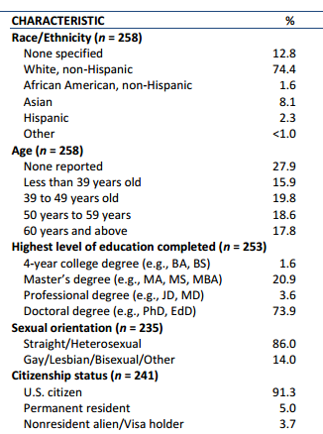
Diversity at Oakland University - Faculty
Faculty Statistics taken from 2013 Oakland University Climate Survey
http://wwwp.oakland.edu/Assets/upload/docs/Diversity/DEI/Faculty.pdf
Response rate: 13.6%
Notes:
Oakland University Climate Survey, Final Analytical Report: Faculty, Staff, and Students. Survey Research Laboratory, University of Illinois at Chicago. 2013. http://wwwp.oakland.edu/Assets/upload/docs/Diversity/DEI/Faculty.pdf

Slide 6
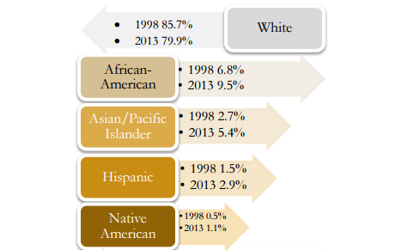
Diversity at Oakland University - Students
Changes in demographics of the student body, data from Diversity at Oakland University: A closer look at underrepresented minorities.
Notes:
Diversity at Oakland University: A closer look at underrepresented minorities. Office of Institutional Research, Oakland University. 2014.

Slide 7
Addressing Biases
“Learning to respect and appreciate each other’s cultural and stylistic differences and becoming aware of unconscious assumptions and behaviors that may influence our interactions will enable us to minimize the challenges and derive maximum benefits from diversity.”
Benefits and Challenges of Diversity in Academic Settings, WISELI, University of Wisconsin-Madison. http://wiseli.engr.wisc.edu/docs/Benefits_Challenges.pdf
This presentation will introduce types of biases and present some solutions for addressing bias in the recruitment and hiring process.
Notes:
Benefits and Challenges of Diversity in Academic Settings. WISELI, University of Wisconsin-Madison. http://wiseli.engr.wisc.edu/docs/Benefits_Challenges.pdf

Slide 8
Types of Bias
Bias may affect a reviewer’s perception of a candidate either negatively or positively.
IMPLICIT BIAS
A positive or negative mental attitude towards a person, thing, or group that a person holds at an unconscious level.
By contrast, an explicit bias is an attitude that someone is consciously aware of having.
GENDER BIAS
Unequal treatment and expectations based on the sex of the candidate. Gender bias is most often reflected in the roles one expects a certain person to have.
CULTURAL BIAS
Interpreting and judging by the standards inherent to one’s own culture.
Culture may include race, ethnicity, age, sexual orientation, and place of residence.
Bias may develop from a history of personal experiences that connect certain groups or areas with fear or other negative perceptions.

Slide 9
Implicit Bias
Common errors related to implicit bias:
Stereotypes
A broad generalization about a particular group and the presumption that a member of the group embodies the generalized traits of that group.
Negative Stereotypes – Negative presumptions such as assuming the member of the group is incompetent in an area, lacks character, or is untrustworthy.
Positive Stereotypes – A halo effect where members of a group are presumed to be competent or bonafide. Positive achievements are noted more than negative performance, and success is assumed.

Slide 10
Implicit Bias
Common errors related to implicit bias:
Raising the Bar –When one requires members of certain groups to prove that they are not incompetent by using more filters or higher expectations for them.
The Longing to Clone – Devaluing a candidate who is not like most of the members on the committee; wanting a candidate to resemble, in attributes, someone one admires and is replacing.
Good Fit/ Bad Fit – How comfortably and culturally at ease one will feel with that candidate is valued more than the candidate’s actual accomplishments and skills

Slide 11
Gender Bias
Gender bias may negatively affect a reviewer’s view of a candidate.
Expectancy Bias
“She has two small children, so she won’t have the same level of dedication and time commitment to her research and teaching as this other candidate.”
This bias is expecting men and women to behave in certain ways.
As a result, this bias appears as a set of expectations about how men and women behave, what they value, and how they interact with other people.
Stereotypical male characteristics/ behaviors: assertive ambitious dominant | Stereotypical female characteristics/behaviors: nurturing/supportive caring subordinate

Slide 12
Gender Bias
Gender bias may negatively affect a committee member’s view of a candidate.
Perspective Gender Norms
“I don’t know about this candidate. I’ve heard that she is extremely self-assured and arrogant. I’m not sure she’s willing to be collaborative.”
Studies show that men or women who do not exhibit the expectant behaviors are scored lower than their fellow candidates.
For example, women who speak confidently about their qualifications are negatively viewed as “self-promoting” because this behavior does not fit the communal stereotype of women.

Slide 13
Cultural Bias and Cultural Competence
What is a “good cultural fit”?
People who conform to the mainstream organizational culture
People we feel comfortable with
Behavior (and visual characteristics) we are used to
Often explained in the context of organizational values
If the committee is too focused with these aspects of finding a “good fit,” they may miss hiring a well-qualified candidate. Instead of focusing only on the similarities of the candidate to oneself or one’s culture, evaluate talent from a more objective point of view and correctly evaluate the candidate’s true strengths. Broaden the view so unforeseen opportunities are uncovered.

Slide 14
Cultural Bias and Cultural Competence
Cultural competence helps colleagues foster better cooperation and minimizes unintended consequences that result from daily interaction. Remember that each person belongs to multiple cultures at once.

Slide 15
Examples of Bias: Gender Bias in Hiring Jennifer or John
When evaluating identical resumes, faculty decision makers may be significantly less likely to agree to mentor, offer jobs, or recommend equal salaries to a candidate if the name at the top of the resume is Jennifer, rather than John.
Background: In 2011, researchers asked 100 biology, chemistry, and physics professors to evaluate two fictitious résumés that varied in only one detail: the name of the applicant.
Female Applicant: Jennifer Male Applicant: John
Institutional Coverage: Nationwide (United States)
Carnegie Related: Large/Research
University-Very High Research Activity, Public and Private
Applicants were seeking the position of “laboratory manager”
Findings in Brief: Despite both applicants having exactly the same qualifications, the professors perceived Jennifer as significantly less competent.
As a result, Jennifer experienced a number of disadvantages – faculty were less like to mentor her or hire her, and were more likely to offer her a lower salary (on average, 13% less than John’s offer).
Find this study at: http://www.pnas.org/content/109/41/16474.full

Slide 16
Example of Bias: Racial Bias in Hiring Emily Walsh, Greg Baker or Lakisha Washington, Jamal Jones
When deciding which applicants to call back for interviews, potential employers may discriminate solely based on linkage of a name with a particular race.
Background: In 2001/2002, University of Chicago and MIT researchers performed a field experiment measuring interview callback rates for résumés reflecting equally qualified job candidates (fictitious résumés) who only differed by name.
Females: Emily/Lakisha Males: Greg/Jamal
Geographic Coverage: Boston, MA and Chicago, IL
Résumés were sent in response to “Help Wanted” ads in Chicago and Boston newspapers
Findings in Brief:
Résumés with “White” (Western European/Caucasian) names received 50 percent more calls for interviews than résumés with “Black” (African-American) names.
Federal contractors and employers who listed “Equal Opportunity Employer” in their job ads discriminated as much as other employers.
Find this study at: http://www.nber.org/papers/w9873
Also: Bertrand, Marianne, and Sendhil Mullainathan. 2004. "Are Emily and Greg More Employable Than Lakisha and Jamal? A Field Experiment on Labor Market Discrimination." American Economic Review, 94(4): 991-1013.

Slide 17
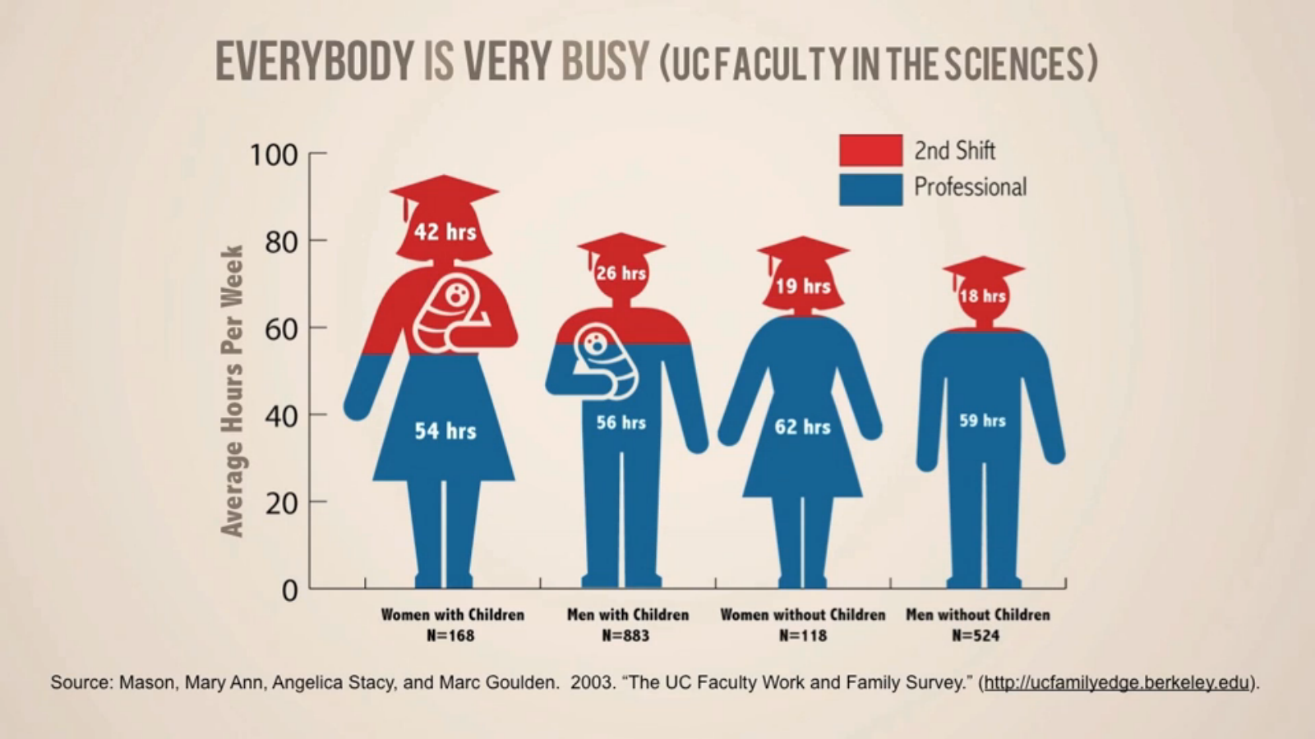
The Need for a Flexible Department Culture
Another aspect of diversity includes family life and responsibilities. A bias against faculty that need flexible schedules may get in the way of good recruitment decisions.
A study argues that both men and women with small children report and resent inflexible department cultures. The study also finds that even non-parents feel this way, with negative consequences for the department over all.
This graphic shows that both male and female faculty with children have busy schedules, and may benefit from flexible department cultures.
Find this study: http://www.pnas.org/content/109/41/16474.full
Graphics from: http://www.toolsforchangeinstem.org/best-practices-for-family-friendly-policies/

Slide 18
Approaches to Countering Bias
Research evidence suggests that successful approaches include:
Counter-stereotypes – Efforts that focus on developing new associations that contrast with the associations already held, through visual or verbal clues. Exposure to people who are identified as counter-stereotypic individuals, such as male nurses, elderly athletes, or female scientists, can help build these new associations and combat bias.
Sense of accountability – The implicit or explicit expectation that one may be called on to justify one’s beliefs, feelings or actions to others can decrease the influence of bias.
Taking the perspective of others – Considering contrasting viewpoints and recognizing multiple perspectives can reduce automatic biases.

Slide 19
Roles and Responsibilities of Search Committee Members
All committee members have some unconscious bias.
A properly functioning committee will help its members recognize and face that bias.
Addressing biases should be done in a collegial and productive manner, helping to check each other’s blind spots.
It is the right and responsibility of a committee member to address an issue if one feels the issue is inappropriately affecting the review process.
To start a dialogue about unconscious bias, consider some of these phrases:
“Does anyone else share my concern?”
“Can we discuss/consider...?”
“Can you tell me again why you rated this candidate so low?”
“My understanding is...”

Slide 20
Developing Guidelines
Committee members should develop a trusting and cooperative environment to work in during the review process.
The committee Chair plays an important role in setting and maintaining this climate.
Best Practice: Develop Guidelines
As a committee, develop ground rules for the expectations and responsibilities of members.
Include guidelines on how to raise contentious issues and handle disagreements.
Use guidelines to address issues professionally and productively when a committee member senses unconscious bias.

Slide 21
Discussing the Candidate
Keep deliberations about candidates skills-based rather than feeling-based.
Feeling-based phrases include:
“I just don’t like him.”
“I don’t think she is a good fit.”
Focus instead on the measureable accomplishments of the candidate, such as experience and publications. These reflect the candidate’s skills and reduce the likelihood of bias in the search committee’s decision.

Slide 22
Identifying Biases
Visit Project Implicit, a site from Harvard that includes tests to identify implicit associations.
https://implicit.harvard.edu/implicit/
The Project Implicit Social Attitudes test looks at associations about race, gender, sexual orientation, and other topics. The test helps reveal the perception of certain groups and helps identify biases.

Slide 23
Conclusion
Consider this presentation as a guide for addressing your own personal biases and those you might encounter.
Be open to discussing and addressing biases during the search process to ensure that candidates are evaluated fairly.
Hiring opportunities don’t come along often and it is important that good decisions be made in recruitment and hiring.
You can help Oakland University grow into a diverse and dynamic intellectual community!

Slide 24
References
Are Emily and Greg More Employable than Lakisha and Jamal? A Field Experiment on Labor Market Discrimination. Marianne Bertrand and Sendhil Mullainathan, American Economic Review. 2004.
http://www.nber.org/papers/w9873
Becoming Bias Literate. CHARGE Committee, University of Virginia. 2015.
http://uvasearchportal.virginia.edu/?q=bias_literacy
Benefits and Challenges of Diversity in Academic Settings. WISELI, University of Wisconsin-Madison. http://wiseli.engr.wisc.edu/docs/Benefits_Challenges.pdf
Bias and Cultural Competence in Recruitment and Selection. Language & Culture Worldwide, LLC.
http://www.languageandculture.com/hr-bias-and-cultural-competence-from-recruiting-to-retaining-a-diverse-workforce
Diversity at Oakland University: A closer look at underrepresented minorities. Office of Institutional Research, Oakland University. 2014.
“Diversity in College Faculty Just as Important as Student Body.” Matthew Lynch, Diverse: Issues in Higher Education. 2013. http://diverseeducation.com/article/52902/
Does Diversity Make a Difference? Three Research Studies on Diversity in College Classrooms. Washington, DC: American Council on Education and American Association of University Professors. 2000. http://www.aaup.org/NR/rdonlyres/97003B7B-055F-4318-B14A-5336321FB742/0/DIVREP.PDF

Slide 25
References
Exploring the Color of Glass: Letters of Recommendation for Female and Male Medical Faculty. Frances Trix and Carolyn Psenka, Discourse & Society. 2013.
http://advance.uci.edu/images/Color%20of%20Glass.pdf
A Guide to Recruiting and Retaining a More Diverse Faculty. College of Sciences and Humanities Task Force on the Status of Women, Ball State University. 2008. https://cms.bsu.edu/-/media/WWW/DepartmentalContent/CSH/PDF/Guide%20to%20Recruiting%20and%20Retaining%20a%20More%20Diverse%20Faculty1.pdf
Helping Courts Address Implicit Bias. National Center for State Courts. 2012.
http://www.ncsc.org/~/media/Files/PDF/Topics/Gender%20and%20Racial%20Fairness/Implicit%20Bias%20FAQs%20rev.ashx
Oakland University Climate Survey, Final Analytical Report: Faculty, Staff, and Students. Survey Research Laboratory, University of Illinois at Chicago. 2013. http://wwwp.oakland.edu/Assets/upload/docs/Diversity/DEI/Faculty.pdf
Reducing Unconscious Bias: A Resource for Hiring Committee Members. Las Positas College. 2009.
http://www.laspositascollege.edu/campuschangenetwork/documents/ReducingUnconsciousBiasF09.pdf
Rising above Cognitive Errors: Guidelines for Search, Tenure Review, and Other Evaluative Committees. JoAnn Moody, Council of Colleges of Arts & Sciences. 2005.
http://www.ccas.net/files/ADVANCE/Moody%20Rising%20above%20Cognitive%20Errors%20List.pdf

Slide 26
References
Science Faculty’s Subtle Gender Biases Favor Male Students. Corinne A. Moss-Racusin, John F. Dovidio, Victoria L. Brescoll, Mark J. Graham, and Jo Handelsman, Proceedings of the National Academy of Sciences. 2012.
http://www.pnas.org/content/109/41/16474.abstract
State of Science: Implicit Bias Review 2014. Kirwan Institute for the Study of Race and Ethnicity, Ohio State University. 2014.
http://kirwaninstitute.osu.edu/wp-content/uploads/2014/03/2014-implicit-bias.pdf
What You Don’t Know: The Science of Unconscious Bias and What To Do About It in the Search and Recruitment Process. Association of American Medical Colleges. 2010.
https://www.aamc.org/video/t4fnst37/index.htm

