Slide 1
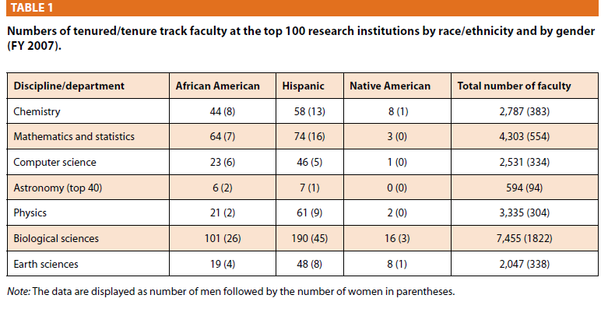
Where are the Women of Color ?
Towns, M. H. (2010). Where are the women of color? Data on African American, Hispanic, and Native American faculty in STEM. Journal of College Science Teaching, 39(4), 6-7.
Notes:
There is a difference between talking about women of color and underrepresented women.
My focus will be on underrepresented female faculty in STEM—namely Black women, Latinas, and Native American women who are faculty
As an IO Psychologists I approached today by focusing on what I already know about the experiences of professional women of color in business and academic contexts where they are also underrepresented through my own research as well as that of others.
After giving this a few days thought, I came away with the larger question of ,

